Slide 1
Angular Beginner Tutorial
In
Tamil

Slide 2
Angular and History
What is Angular?
Angular is a JS framework which allow you to create reactive Single Page Application.
Angular is building Mobile and desktop web applications
It written typescript-based open source web application framework led by Angular team at Google.

Slide 3
Angular Js vs Angular
Angular Js - The architecture of AngularJS is based on the model-view-controller (MVC) design. It is first version of Angular – oct-2010
Latest version – Angular 9 . Every six month release version.
Angular JS | Angular
MVC Design | Components and Modules
It is written in Javascript | It is written in Typescript
Not build in Mobile support | Mobile Support
$routeprovider.when() to configure routing | uses @RouteConfig{(…)}
Performance AngularJS was originally developed for designers, not developers | Better performance
Angular Js (V1)
Angular (V2)
Angular (V3)
Angular (V9)

Slide 4
Angular 9 Features
Welcome Default Ivy - the Ivy renderer is the default Angular compiler
- "angularCompilerOptions": { "enableIvy": true }
Angular Core Type-Safe Changes - One of the APIs for testing Angular apps is called TestBed
- TestBed.inject(ChangeDetectorRef) // ChangeDetectorRef
ModuleWithProviders Support
- All of your code becomes in sync with the latest changes
- ng update
Changes with Angular Forms
- <ng-form></ng-form>
- FormsModule.withConfig has been removed and you can now use the FormsModule directly
Dependency Injection Changes in Core
- @Injectable({ providedIn: 'platform' }) class MyService {...}
Enhancement of Language Service
Service Worker Updates
i18n Improvements
API Extractor Updates
Angular Component Updates

Slide 5
Updating to Angular Version 9
Updating CLI Apps
For step-by-step instructions on how to update to the latest Angular release, use the interactive update guide at update.angular.io
If your application uses the CLI, you can update to version 9 automatically with the help of the ng update script:
- ng update @angular/core@8 @angular/cli@8
- git add .
- git commit --all -m "build: update Angular packages to latest 8.x version"
- ng update @angular/cli @angular/core --next`

Slide 6
Prerequistes:
- HTML,
- CSS,
- Javascript,
- Typescript
- Node js ( based on Angular version 9 – node version 10 and above)
- npm install –g @angular/cli
IDE:
- Visual studio Code
Version check:
- node –v, npm –v, ng version

Slide 7
CLI Commands:
https://angular.io/cli
ng help
ng generate --help
ng new my-first-project
ng serve
ng build my-app -c production
ng g m moduleName –flat –module=app
ng g m moduleName –routing
ng g c componentName --skipTests=true --inlineStyle=true

Slide 8
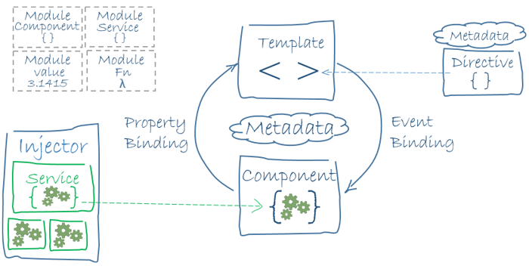
Building block of Angular
Modules
Components
Templates,
Metadata
directives, and data binding
Services and dependency injection
Routing

Slide 9
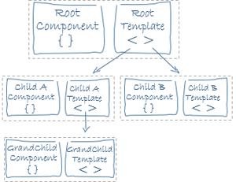
Templates and Views
templateUrl
template
styles
styleUrls

Slide 10
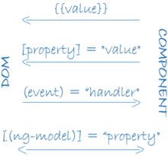
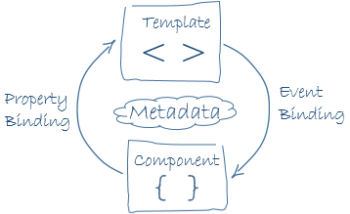
What is Databinding???
Data binding is the core concept of Angular 9 and used to define the communication between a component and the DOM
String interpolation – {{}}
<li>Name: {{ user.name }}</li>
Property Binding – []
<input type="email" [value]="user.email">
Event Binding – ()
<button (click)=“checkMail()"></button>
Two-way Data Binding – [()]
[(ngModel)] = "[property of your component]"

Slide 11

Directives
used to manipulate the DOM.
you can change the appearance, behavior or a layout of a DOM element. It also helps you to extend HTML.
Component Directives
Component directives are used in main class. They contain the detail of how the component should be processed, instantiated and used at runtime.
Structural Directives
*ngIf Directive, *ngSwitch Directive, *ngFor Directive
Attribute Directives
ngClass Directive, ngStyle Directive
Custom Directives

